Slide 1
Strengthen PSNV Monozukuri system to increase productivity
MAIN CONTENTS
1
New Assignment & Responsibilities
Page 1
2
Background To Select Theme
Page 2-3
3
Improvement Schedule
Page 4
4
Detail Improvement Activity
Page 5 ~ 11
5
Next Action/Improvement
Page 12
Presented by : Nguyen Duy Thanh
Joined in : 07th . Apr . 2014
Section : MQA
Current position : Supervisor
New position : Specialist
Notes:
Good morning everyone. I would like to present my promotion report. My theme is “Enhancement quality improvement by standardization process verify system”
There are five main contents as mentioned here. I will report detail next pages.

Slide 2
New Assignment & Responsibilities
1/12
New Organization Chart after Assignment
<Before>
<After>
Monozukuri Quality Assurance
Product Quality Assurance
(2)
MQA
Head: MGR. Ha
(11)
MQA
Head: MGR. Ha
Sup D.Thanh
Head:
Specialist D.Thanh
Factory Patrol Quality Control
(7)
Daily Patrol team
(11)
FPQC
Officer Hoa
(4)
New model &
4M control team
Head: Specialist V.Thanh
Outgoing Quality Control
(Add) Specialist D.Thanh
OQC
OQC
Head: MGR. Tu
Head: MGR. Tu
New Mission:
① Manage the daily patrol activities to ensure quality in processes
② Manage & checking new model to ensure quality from PP step
③ Verify K.I.S.S Activity of all categories

Slide 3
Background To Select Theme
2/12
Overview PSNV situation
M$
Sales Amount
M$
Labor cost
PSNV missions
216
196
208
245
219
Reduce Fix cost and received new category
Sales not increase
Labor cost yearly up 7%
Manufacturing
New Model Situation
Monozukuri Pending point:
Monozukuri issue repeat happen
Not spread good points fully (BU/BD)
High stop line time (Checker & quality)
3 companies・5 BU/BD・15 categories
Yearly receive many new models / category
Need to establish MQA Section
Review Monozukuri activities of MQA
MQA mission
FY2022
FY2023 ~ FY2024
Expand MQA Activity to Increase productivity & product quality
1. Ensure Monozukuri quality
Establish MQA Section
Make Monozukuri procedure
Check all checker changing
Build PSNV verify concept
2. Build up good system for new
category
3. Increase productivity inline
Theme : Strengthen Monozukuri Quality System to increase quality & productivity
Notes:
First in my Project, I want to improve 3 issue of PSNV
Now I’d like to explain background
For PSNV sale amount : Current category sale down but we have chance to improve because New category come. But after some month running for quality we face with many problem.
So It’s QC main responsibility, so I take action to organize quality management system.
Secondly for Product Quality , this time both of Market and OQC issue did not achieved target and Factory Loss cost Big amount. To ensure Market quality. In this project, I focus into take preventive action
Next for Company profit, as current situation Profit effect by labor cost yearly up to 7%
So if we no take action, Profit will be negative .
So all section should be improve to to contribute for PSNV over come this situation. So for OQC , this year I set up target for reduce labor cost 14%
To achieved we have to improve OQC efficiency.
That why I select these activity & from now on I would like to explain in details.

Slide 4

Background To Select Team
3/12
Item | PSNV Background | Pending Issue & Mission
Quality |  | Monozukuri issues happen in OQC & Market with high ratio
New Category |  | Still happen HARENCHI issues for new category
Productivity |  | High solving time for Monozukuri issues inline
OQC/Market issue (FY22)
Issue ①
Monozukuri issues
Mission: Reduce Monozukuri issue
Prevent problems inline before happen
Receive new TV category (FY23)
Issue ②
Monozukuri defect at MP step (Apr ~ Sep)
3
Appearance issue
Man
12%
Method 88%
Ship include jig
Mission: Build up good quality system for new category
4
Ship with control sheet
HARENCHI Issue
Inline Monozukuri stop line (FY22)
Issue ③
Case: 5874 Time: 8237 (h) ➔ SCBU lost: 8590$
Affect to productivity
(Almost not achieve target)
Highest
Mission: Reduce Monozukuri solving time to increase productivity

Slide 5
Total Improvement Schedule
4/12
Plan:
Actual:
Pending Issue | Pending Item | Activity Content | FY2023 |  |  |  | P.I.C | Target (/Year)
 |  |  | 1Q | 2Q | 3Q | 4Q
 | Monozukuri issues happen in OQC / Market with high ratio | ・ Merged with FPQC section to daily patrol risk on process ・ Build New MQA standard check-list for all BD/BU ・ Train to increase quality mind of all members ・ Making smart WI video project (MW–SCV line) |  |  |  |  | MQA FA FE | ・Risk ratio find out: 70% (MQA) ・MQA & IPQC member skill : 4 ・Operator quality mind increase ・Smart WI video project: DONE 20%
 | Still happen HARENCHI issue for new category | ・ Combine with FA centralize team to build horizontal C/M standard |  |  |  |  | MQA FA | ・DONE Horizontal C/M standard
 | High solving time for Monozukuri issues inline | ・ Built 4M system online to synchronize ・ Combine with PE & FA to establish the efficiency improvement team |  |  |  |  | MQA FA PE IT | ・DONE 4M system online ・Reduce stop line time (△ 2,471Hour ~ 30% with FY22) Target: 5,765H
Issue

Issue

Issue
●

Slide 6
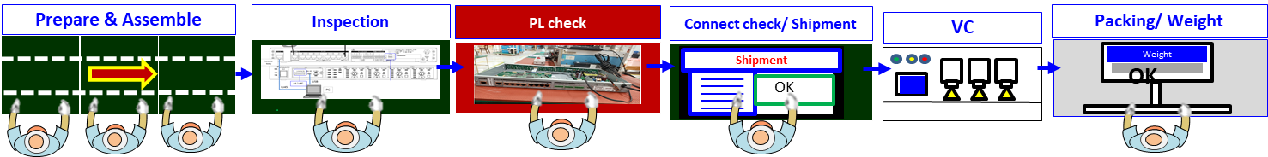



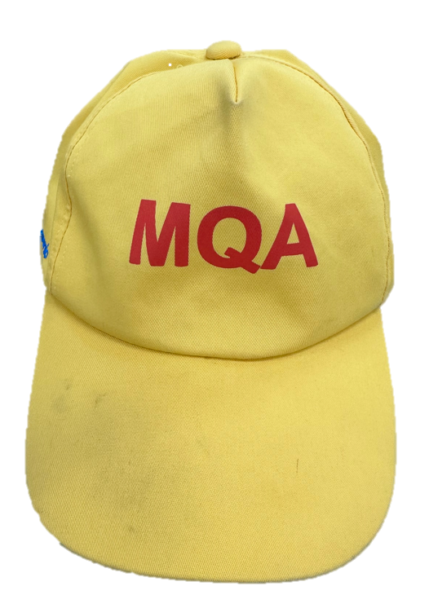

Detail Improvement Activity
5/12
Issue ①
Monozukuri issues happen in OQC / Market with high ratio
Current process quality control
Action : Push risk finding activity
Production line overview
Merged with FPQC section (Apr.2023)
MQA
(2 members)
FPQC
(10 members)
FPQC / IPQC
MQA
Job scope: Focus check risky point inline
Focus to check 3 points (QP – WI – Actual)
Focus to check checker changing issues
Result:
Risk find out ratio still low (~35%)
Find out operation mistake only
Find out risk / problem of checker only
OQC problem
9
Monozukuri issue
Finding
issue
Risky point finding out activity inline still weak
Pending points: Low risky finding out inline ➔ Monozukuri OQC issue still happen highly
Pending point analysis: Low risk ratio / OQC issue
MQA / IPQC members skill
Main Cause:
❶ Low experience to find out risky point / problem
(MQA / IPQC members)
❷ Have no risk checking standard (MQA)
❸ Weak Quality mind of operator
Need to take actions for 3 causes
Problem Solving
Averange
Patrol
Skill
Team work
3.1
Communication
Knowledge

Slide 7
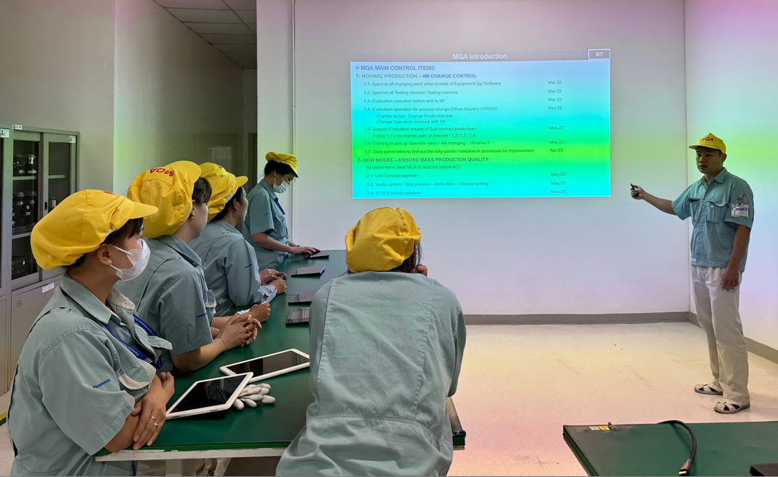
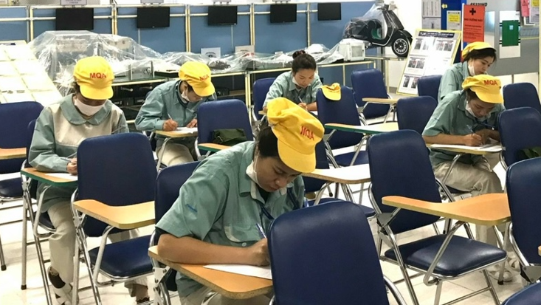
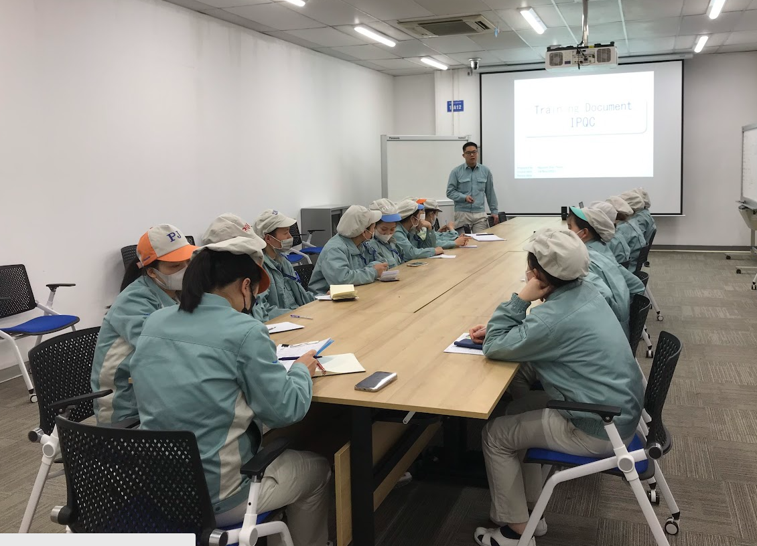
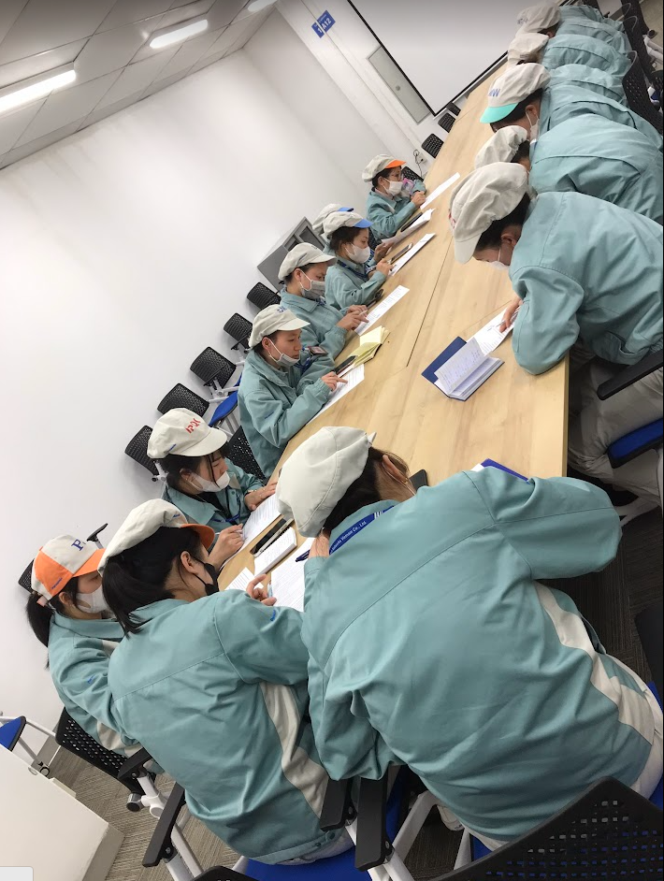
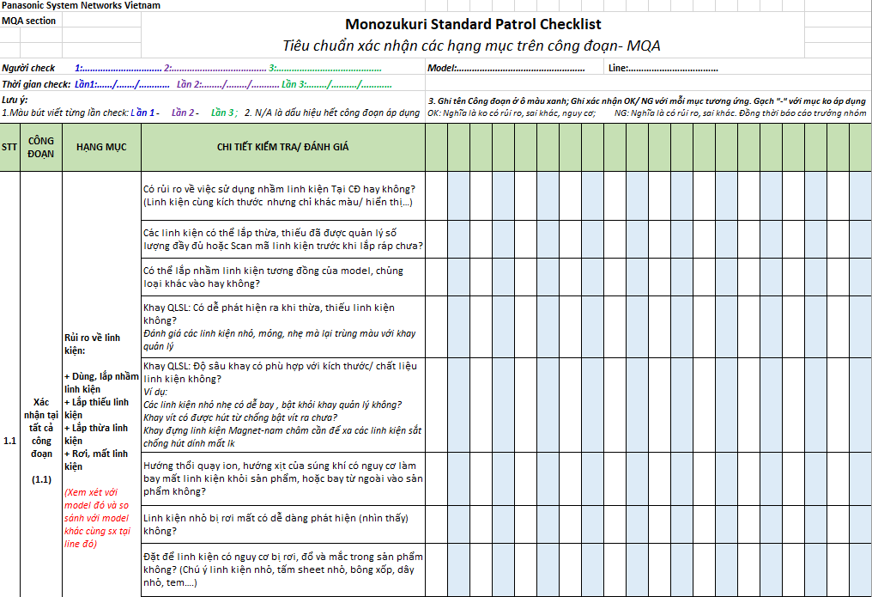
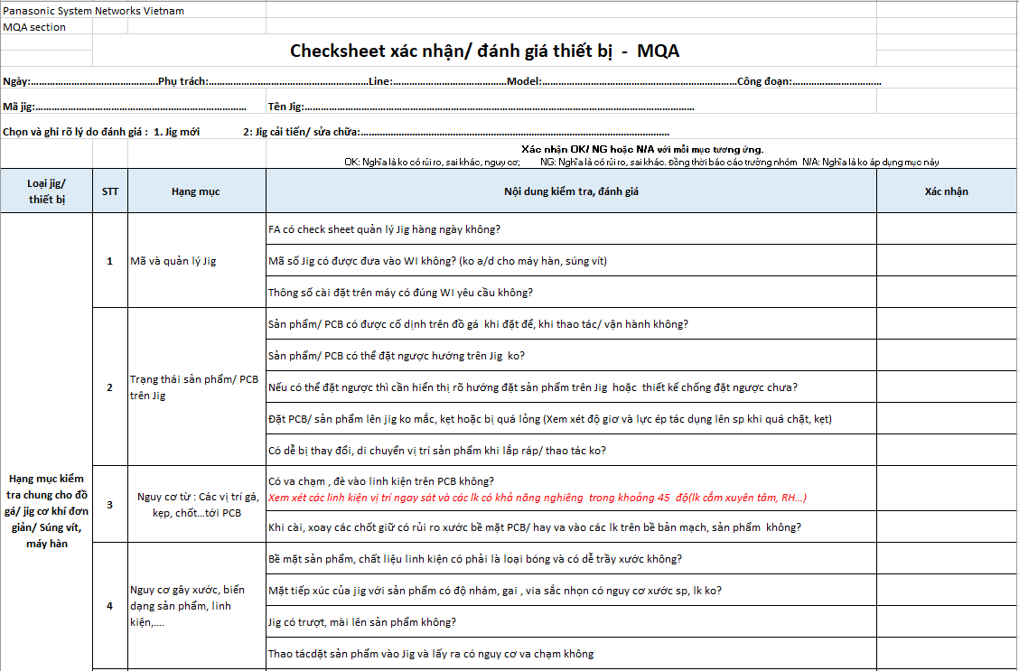
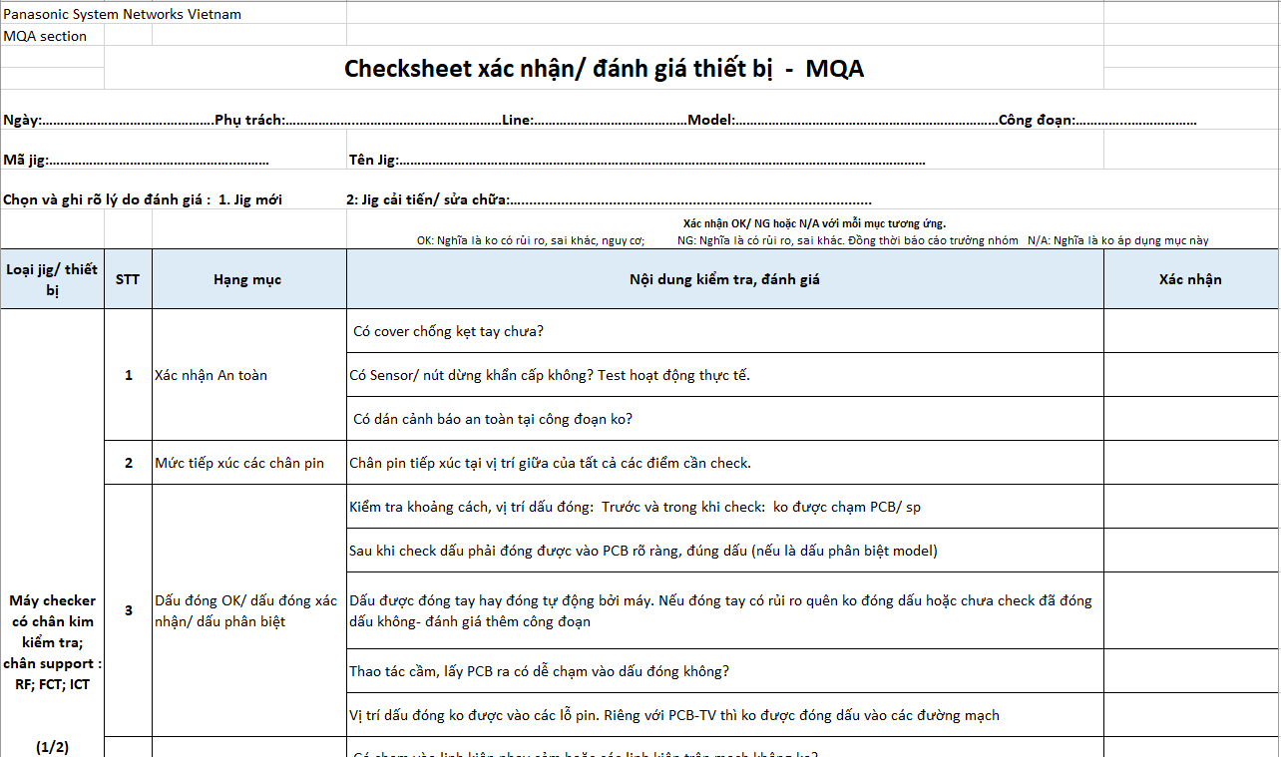
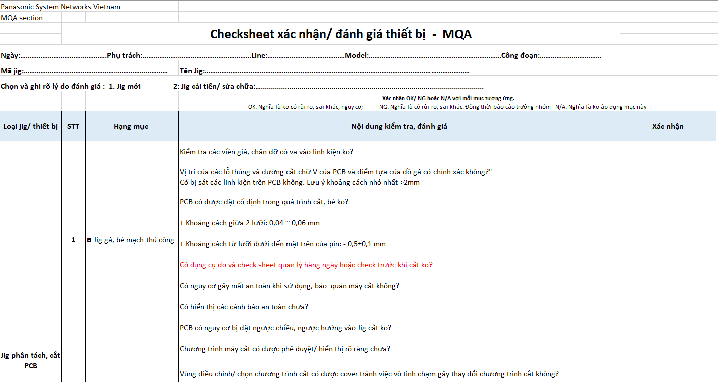
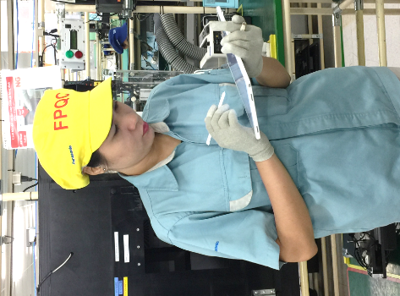
Detail Improvement Activity
6/12
Issue ①
Monozukuri issues happen in OQC / Market with high ratio
Action ❶ : Skill up MQA / IPQC about patrol & knowledge
● <MQA> Holding Monthly training & contest class
● Total: 9 members
❶ Collect all issues in month
Monthly testing result (Pass score: ≥ 80)
Monthly training
Contest
❷ Making training & testing
(From Sep.2023)
❸ Scoring and evaluation
● <IPQC> Holding 3 class level up knowledge
● Total: 19 members
Class 1: Patrol & solving skill
Class 2: Important Equipment
● Pass 100% exams
Training
Contest
Class 3: QP reading method / English words
(Dec.2023)
Action ❷ : Making checking standard for MQA member
Review MQA checking item
Risky point / Problem inline
New jig / Repaired jig
● Action : ► Making Monozukuri standard patrol
& jig / checker evaluation checklist for all BD/BU (Sep.23)
Daily Patrol
New & Repaired jig / Checker
Monozukuri patrol
Support jig
RF/ICT/FCT
Panel pressure
PCB divide
● Pending point :
Have no standard document for checking & evaluation
❶ Summary good points / risky points /
problem history from all BU / BD
Deeply check risky point
❷ Weekly review & update

Slide 8

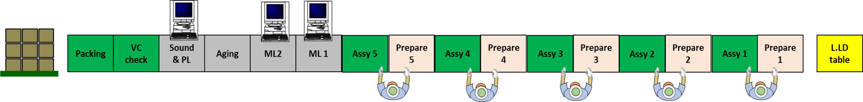
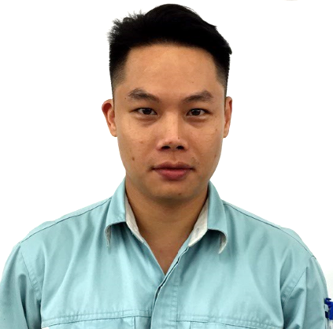
Detail Improvement Activity
7/12
Issue ①
Monozukuri issues happen in OQC / Market with high ratio
Action 3 : Increase Quality Mind of operator
Transfer 4M training document to FA side (Apr.2023)
► Monthly training for all operators
Making Smart WI video project to remind operator always
Apply Model: MW–SCV3C (Sample) ➔ Transfer making method to FE side after done
Project Content:
Making WI video of each process
(Hight light caution points)➔ Repeated play
Jan.2024
Showing video
(Repeat)
Highlight caution point
Tablet
Tablet
THANH
MQA Leader
No | List Jobs | Progress
1 | List processes / each step of process | Jan.2023 <DONE>
2 | Summary risky / caution points list | Jan.2023 <DONE>
3 | Making video for each process | DONE 40% (2/6 processes)
PHU
FE Manager
/ FE members
VIET
MW Manager
/ FA members
Total Improvement Result:
MQA patrol result (Sep ~ Feb.2024)
MQA / IPQC members skill
Problem Solving
Risk ratio find out >70% (From Oct)
Team work
Before
3.1
Patrol
Skill
OQC problem
3 Monozukuri issue
After
4.3
Communication
Knowledge
Quality Mind of all operators are increased

Slide 9
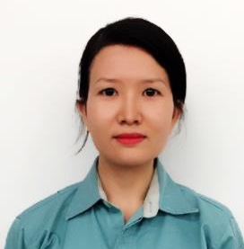
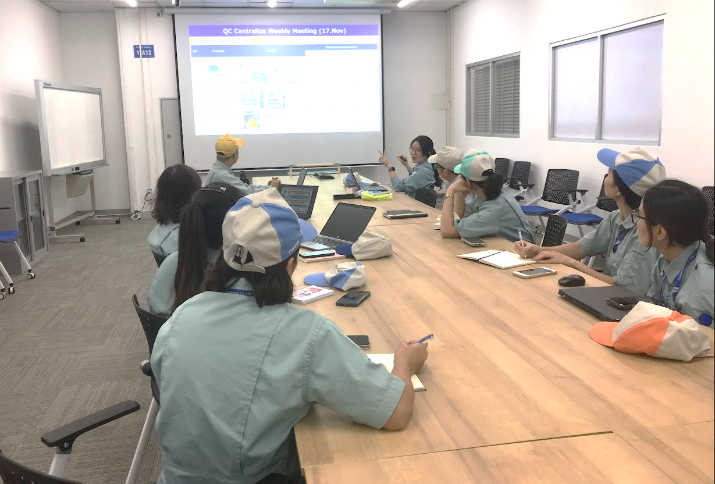
Detail Improvement Activity
8/12
Issue 
Still happen HARENCHI issue for new category
TV - HARENCHI defect analysis
Action : Combine with FA QC Centralize to build Standard project
BD/BU | Jig control method
KABD/ MEBD / SCBU | Control by checklist & barcode daily
VSBU | Not control
From Oct.23
THANH
THUY
MQA Leader
QC Centralize Leader
MQA members
QC Centralize members
Mission:
Make horizontal countermeasure apply standard to prevent HARENCHI defect (All BD/BU)
Finding issue
Lack of management:
No standard to horizontal apply countermeasure in factory
Detailed Action
Weekly Activity– Production QC Centralize & MQA Meeting
Making C/M Ranking rule ➔ Review problem – Horizontal Activities
C/M Rank | Define C/M rank | Adding standard
A | Apply all cat. | Production std.
B | Apply each cat. | 1st check-sheet / WI / Countermeasure list
C | Apply each model
D | Training / Temp. | -
Improvement Result (Oct ~ Feb.24)
❶ Review 1200 countermeasure for ranking
❷ Adding Countermeasure result
C/M Rank A | 25 Issue | C/M Rank C | 354 issue
C/M Rank B | 153 Issue | C/M Rank D | 668 issue
Weekly meeting:
Sharing Know-How & Problem / Risky point
Review & Discuss about C/M effectiveness
Ranking for each C/M ➔ Add into standards
➔ Standardization for all new cat. before AQ1
C/M Rank A
AQ2
Shipment
AQ0
R1
AQ1
PMP/MP

Slide 10




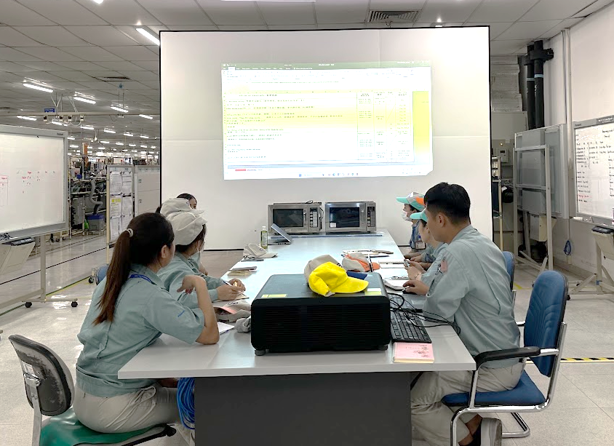
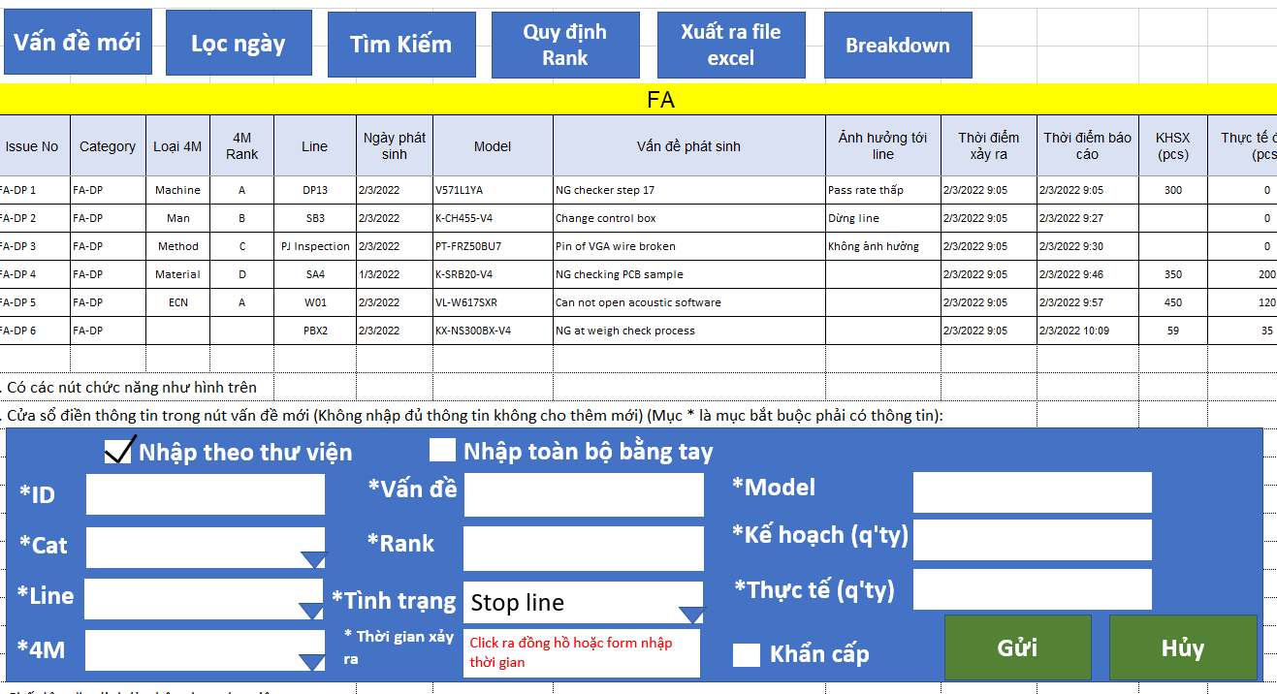
Detail Improvement Activity
9/12
Issue 
High solving time for Monozukuri issues inline
Affection factor analysis
❶ Review current 4M changing system
Monozukuri Solving time:
❶ 4M changing system
Horenso situation of 4M changing
❷ Monozukuri issues quantity
Solving method for Monozukuri issue
Weak point:
Lost time for Horenso
Silent change or inform lately
Easy to miss information
LINE
Phone
4M form
Many ways to inform 4M
Pending points:
4M changing system not yet centralized
Action ❶ : Building up online 4M centralize changing control system
Project Progress
FA
IQC
Smart 4M Server
ANDON System
DONE
Leader
Thanh/MQA
① Review current 4M system | Apr.23
② Build new 4M system procedure (Working method, interface, function..) | May.23
③ Transfer to IT for Web programming | May.23
④ IT development | FY24
IT
OQC
FA side
Other sections
Meeting
FE
PE
Good points:
Procedure
● All 4M changing will synchronized in 1 system | ● Smart filter trending problem inline
● Horenso problems quickly | ● Quick alarm & traceability
● Prevent silent changing / Miss information | ● Saving cost: ~ 8,500$/Year

Slide 11


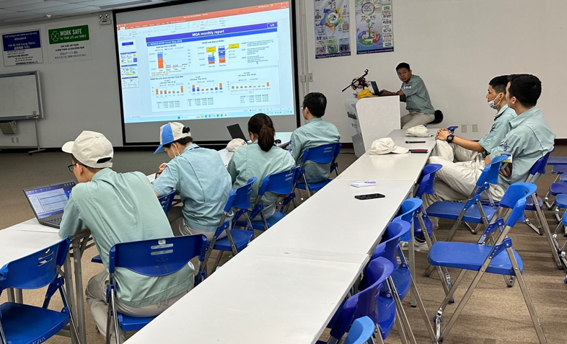

Detail Improvement Activity
10/12
Issue 
High solving time for Monozukuri issues inline
❷ Current solving Monozukuri issues situation
①
②
③
Pending points:
Not overview Monozukuri issues
Finding out trending problems
Taking out strong C/M
FA side
inform problem
PE side
confirm & repair
MQA confirm improving result
Solving Time Breakdown for Monozukuri issues (FY22)
Only repair machine when having trouble
Poor actions
Countermeasure target
► Focus in Rule
► Focus in Standard
► Focus in System
Action ❷: Increase Countermeasure efficiency for Monozukuri issues
● Action : ► Combine with PE/FA section to establish the efficiency improvement team:
Monthly meeting
Improvement Result:
❶ Summarize all defects inline month
❷ Study about the trending defects inline
❸ Discussion about trend defects ► Taking out strong countermeasure
 Following effective of previous actions
● Trending issue finding out
(Sep ~ Feb)
MQA
Total solving: 15 trending issues
Leader
Thanh/MQA
Total Saving Time: 2000H
● Total solving time in FY2023
Target | Actual
5,765H | 5,000H
FA
PE

Slide 12
Summary Improvement Result
11/12
Issue 
Target
Result
Judge
Quality
○
Find out Monozukuri risk on process
>70% (From Oct)
Ratio: 70%
○
Skill up MQA / IPQC members
Skill point: 4
Skill point: 4.3
Increase quality mind of operators
4M training 1time/month
DONE 40% video project
(2/6 process / SCV3C)
Training 1time/month
DONE 4/6 process
(Jun.2024 DONE all)
○
➔
Issue 
New Category
Target
Result
Judge
○
Build horizontal C/M standard
DONE
DONE (Oct)
Issue 
Productivity
Target
Result
Judge
○
Building up online 4M centralize system
DONE
Progress: 70%
(DONE in FY24)
➔
○
Reduce stop line time
5,765H
5,000H
PSNV MONOZUKURI SYSTEM is strengthened

Slide 13
Future Activities
12/12

Slide 14






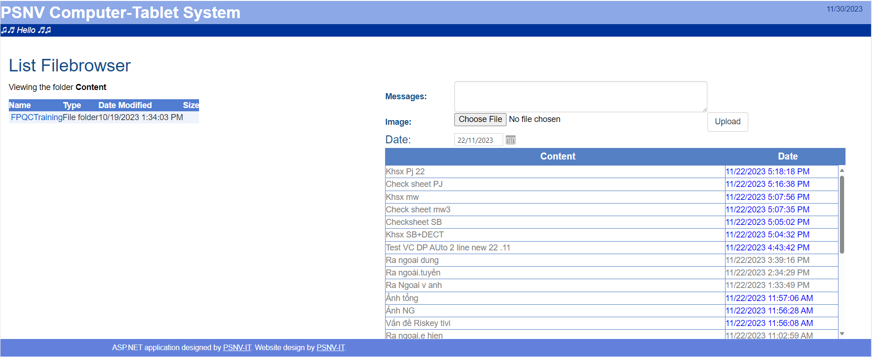
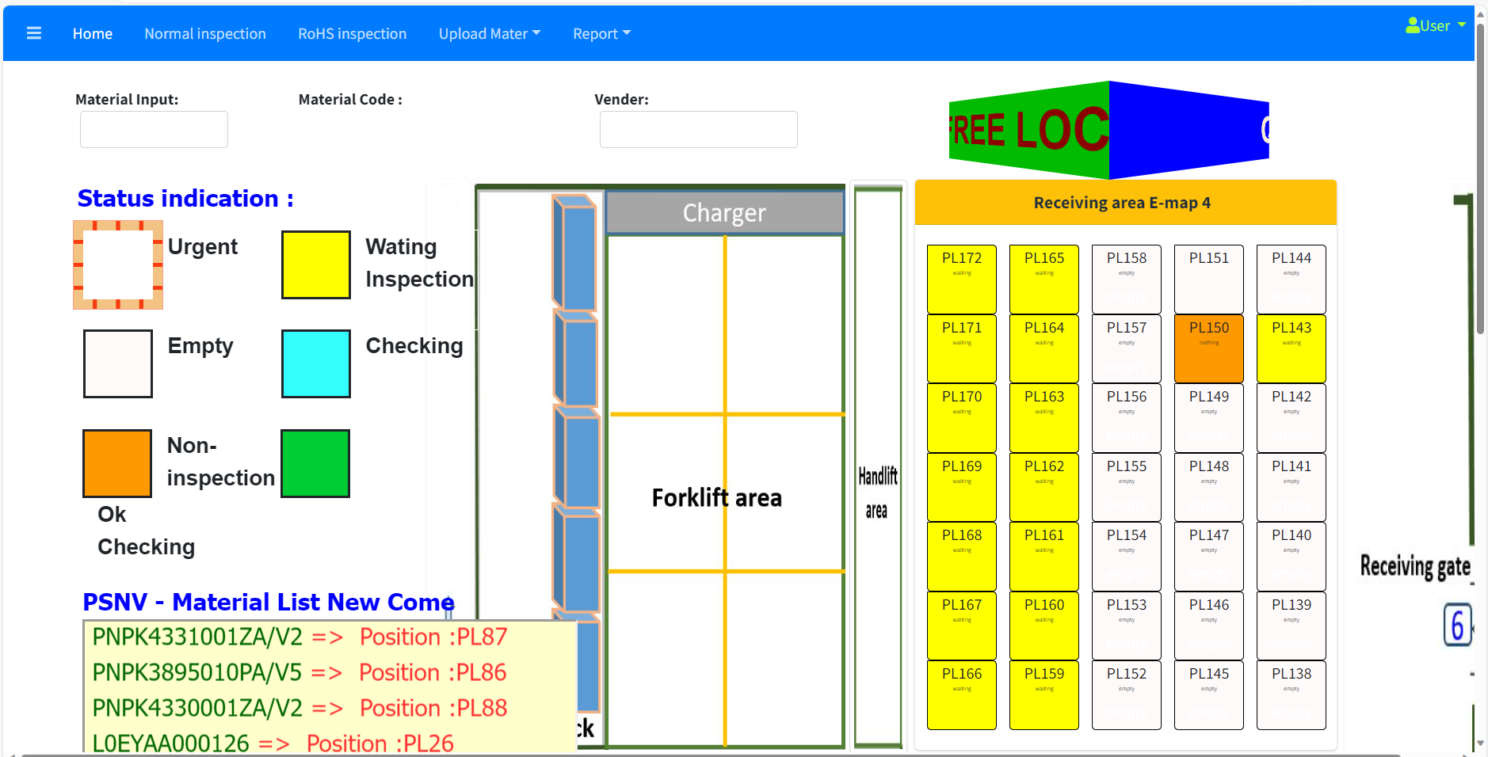
















Personal profile & Achievement
3/11
Join PSNV-IPQC Section as officer
Built IPQC tablet system
Built IQC - MCS free location system
2014
2016
2020
2021
2022
Promote to supervisor
Working at IQC
Working at MQA section

